Slide 1
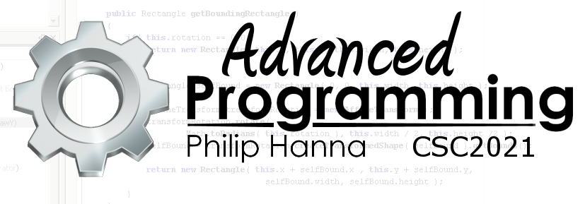
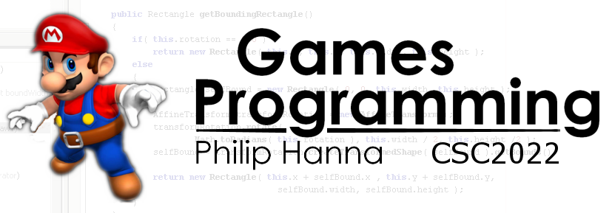
Introduction to C++
Important introductory slices of C++ for Java and C# programmers.
Part 2: A Compiled Language

Slide 2

C++ as a compiled language
C++ is a compiled language and differs from C# and Java which are (mostly) incrementally compiled.
Notes:
C++ is a compiled language. It differs somewhat from C# and Java which can be viewed as incrementally compiled (a cross between a compiler and an interpreter – but more on that later).

Slide 3
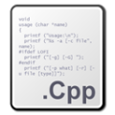
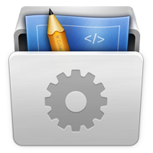
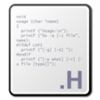
The process of writing and executing a C++ program is as follows:
Phase 1: Creating a Program
Edit and produce one or more source files (.cpp/.h) within a development environment (Visual Studio in our case)
Notes:
Phase 1: Creating a Program
Edit and produce one or more source files (.cpp/.h) within a development environment (Visual Studio in our case)

Slide 4
Phase 2: Preprocessing
A preprocessor process is executed before the compilation begins.
The preprocessor applies directives that modify and change the source files. This can involve inserting other source files, text replacement, etc.
#ifndef
#endif
#include
#include
Notes:
Phase 2: Preprocessing the source files
A preprocessor process is executed before the core compilation phase begins.
The preprocessor executes directives that can modify and change the source files to be compiled. The directives can involve inserting other source files into this file, performing text replacement, etc.

Slide 5


Phase 3: Compilation
A compiler translates the C++ program into machine-language (or near machine-language) code referred to as object code.
Notes:
Phase 3: Compiling a C++ Program
A compiler translates the C++ program into machine-language (or near machine-language) code referred to as object code.

Slide 6


Phase 4: Linking
The object code is next linked together – pulling in any used classes/functions within linked libraries, etc. The linker also adds loading code to produce an executable program.
Notes:
Phase 4: Linking
Object code produced by the compiler typically contains ‘holes’ – references to classes and functions defined elsewhere (within libraries, etc.). The linker links the object codes with the missing functions and adds loading code to produce an executable program.

Slide 7

Phase 5: Loading
The executable program is brought into memory by the loader.
Phase 6: Execution
Execution begins.
Notes:
Phase 5: Loading
To commence execution a program must be brought into main memory by a loader. The loader transfers the executable image from disk to memory and loads any additional components from shared libraries.
Phase 6: Execution
The program begins execution.

Slide 8
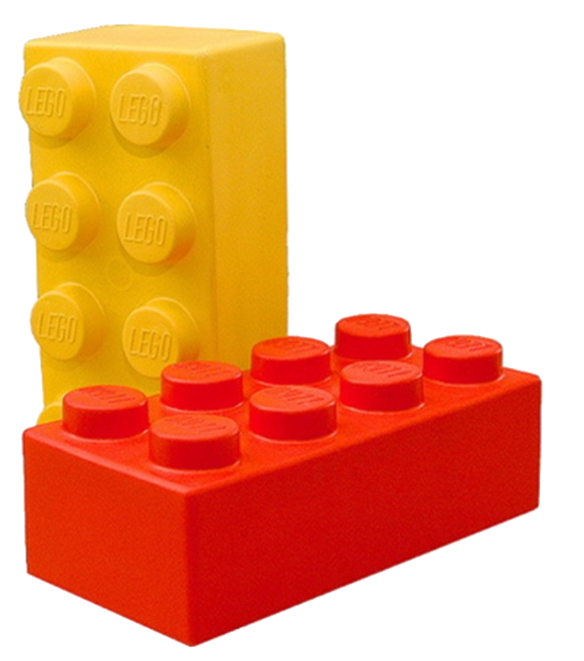
Building Large Projects
Each source file is separately compiled before being linked into the final executable.
This approach works well for large projects as only changed files need to be recompiled and then linked with already compiled object files.
Makefiles and build scripts determine the precise build order.
Notes:
The compilation process and large projects
In C++ each source file is compiled separately (as a standalone entity) and then linked together into the final executable program.
This has advantages. If only one file is modified then only that file needs to be recompiled. It can then be relinked with the other already compiled files. This improves build times on larger projects.
Makefiles and build files are both scripts that determine how a large process is build (defining the order in which things are compiled, etc.). Tools such as MSBuild or Ant can process make and build files.

Slide 9

Key takeaways:
C++ is a compiled language in which the different steps/stages (from source to executable) are all easily accessible/configurable.

